Slide 1
Graphic Novels
Year 8

Slide 2
What are graphic novels?
Graphic novels are books written and illustrated in the style of a comic book.
To be considered a graphic novel, rather than a picture book or illustrated novel, the story is told using a combination of words and pictures in a sequence across the page.
Graphic novels can be any genre, and tell any kind of story, just like their prose counterparts. The format is what makes the story a graphic novel, and usually includes text, images, word balloons, sound effects, and panels.

Slide 3
Both images and words tell stories.

Slide 4
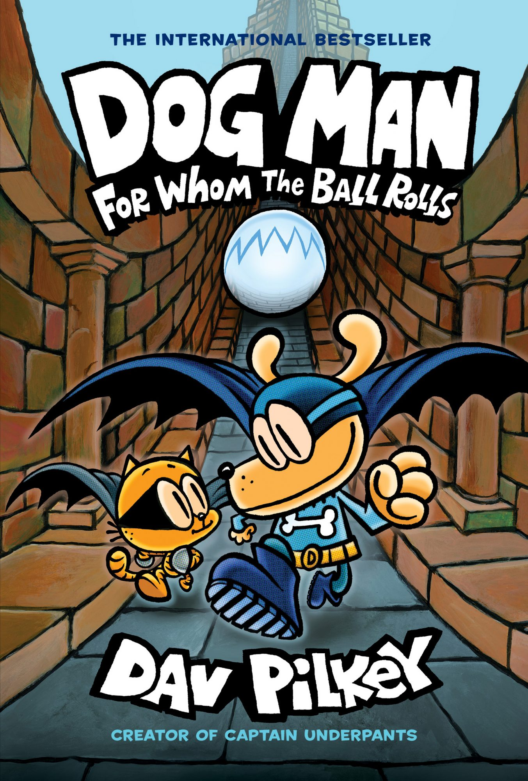
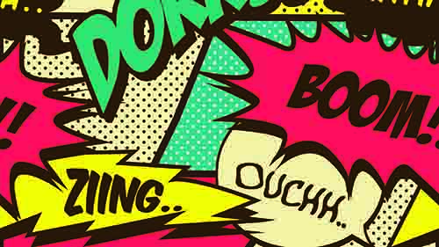
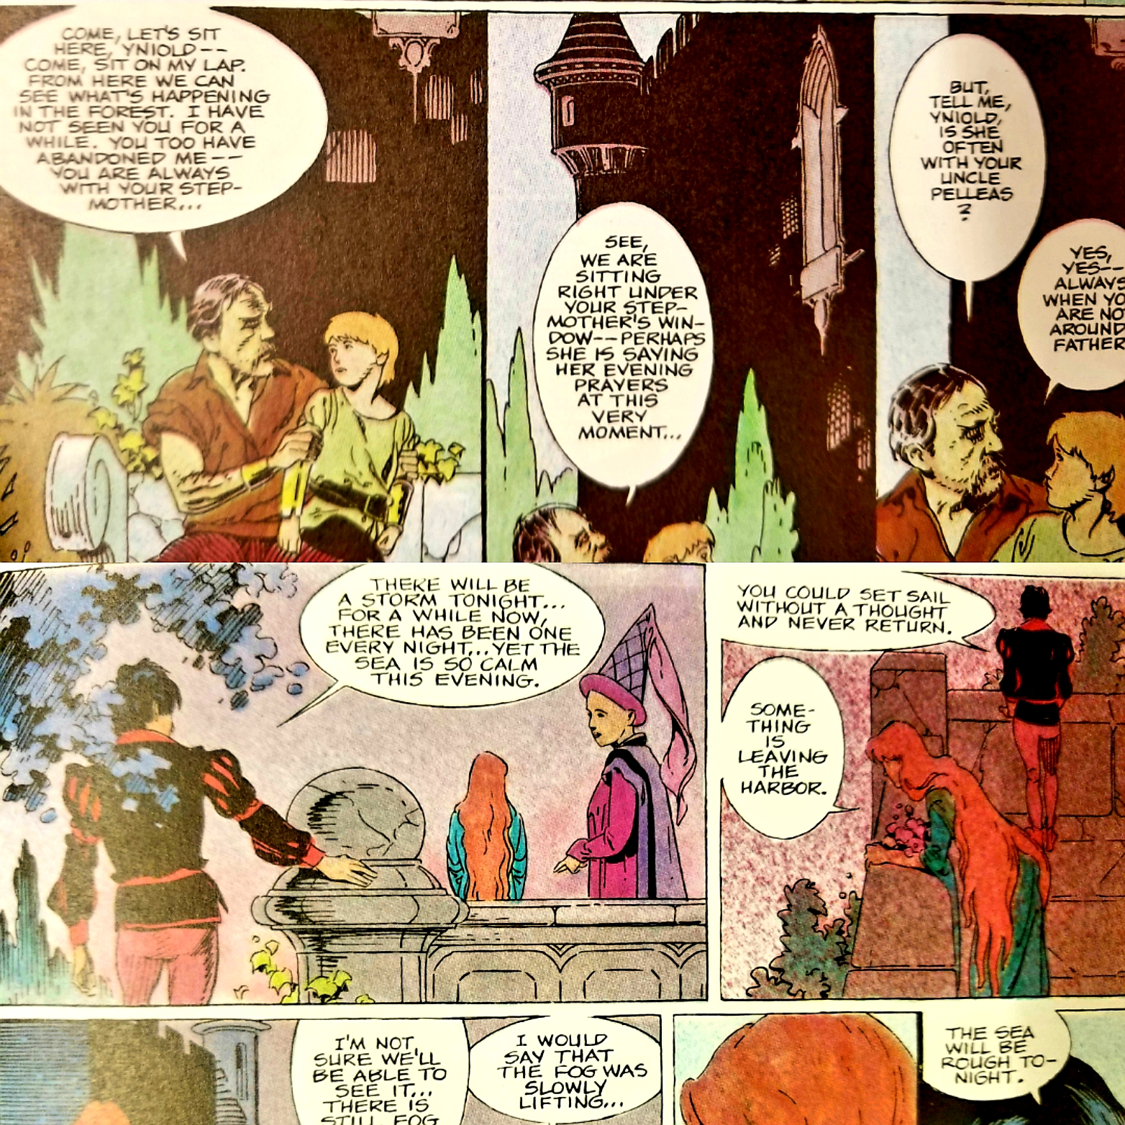
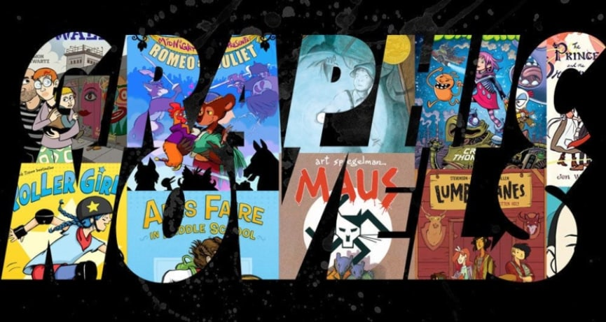
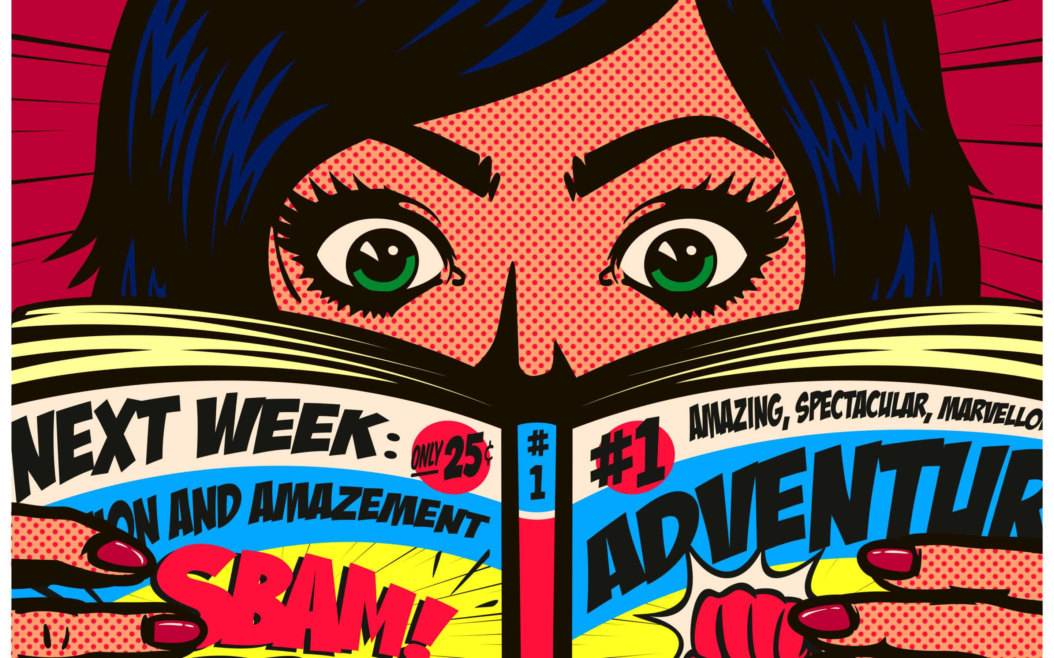
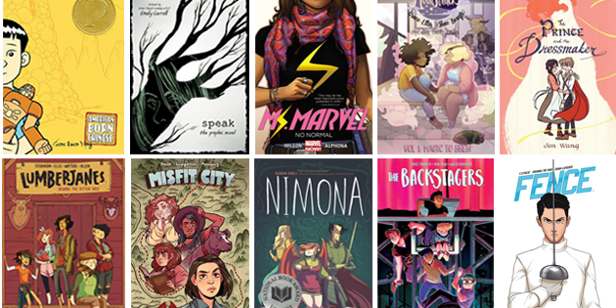

Slide 5
Graphic Novel Terms
Today we are going to create a dictionary of elements that are unique to graphic novels and comic books.

Slide 6
Graphic Novel Terms
Speech Bubbles
Captions
Panels
Thought Bubbles
Sound Effects

Slide 7

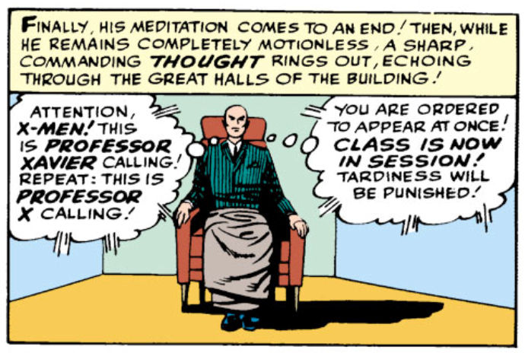
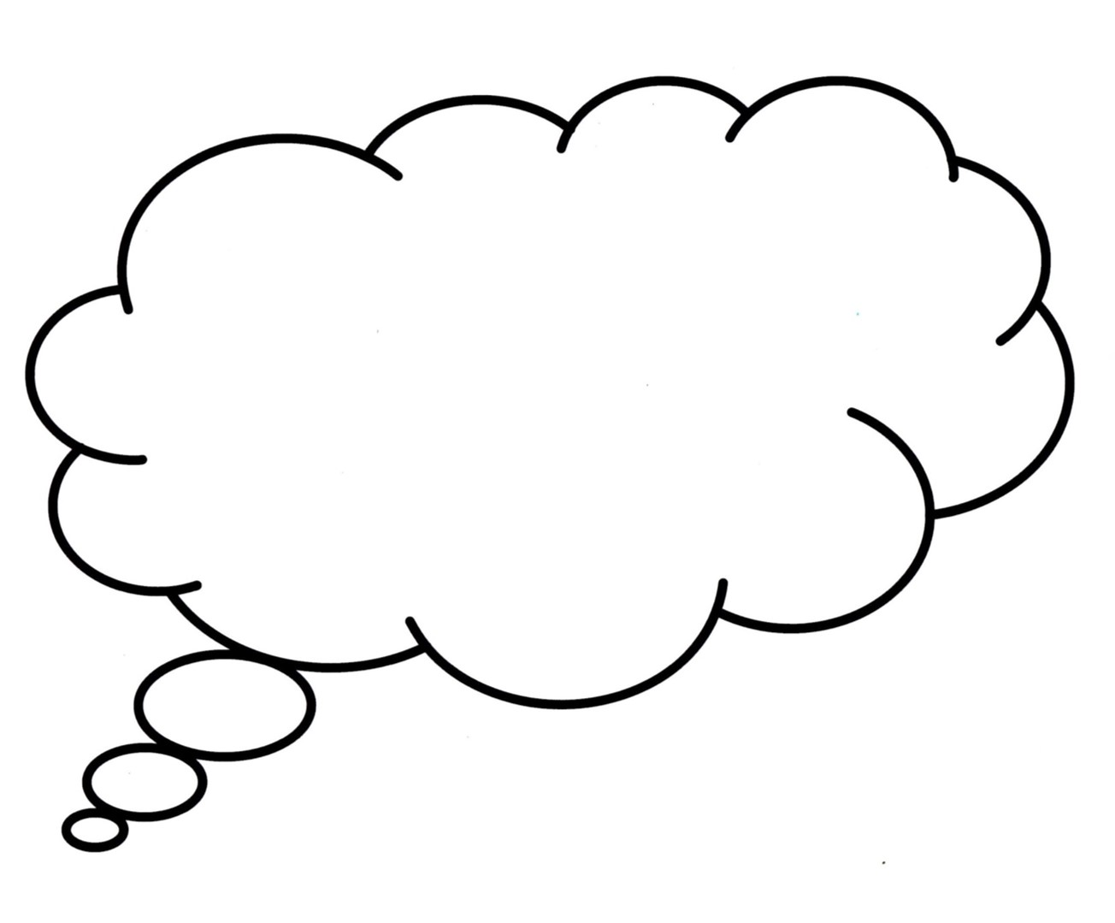

Graphic Novel Terms
Speech Bubbles
Captions
represent the speech of a character.
contain information about a scene or a character and are generally used to establish time and place.
Panels
contain the text and illustrations of a single scene.
Thought Bubbles
represent the thoughts of a character.
Sound Effects
or onomatopoeia’s are visual sound clues e.g. ‘zonk’ and ‘whoosh’.

Slide 8
Graphic Novel Exploration

Slide 9
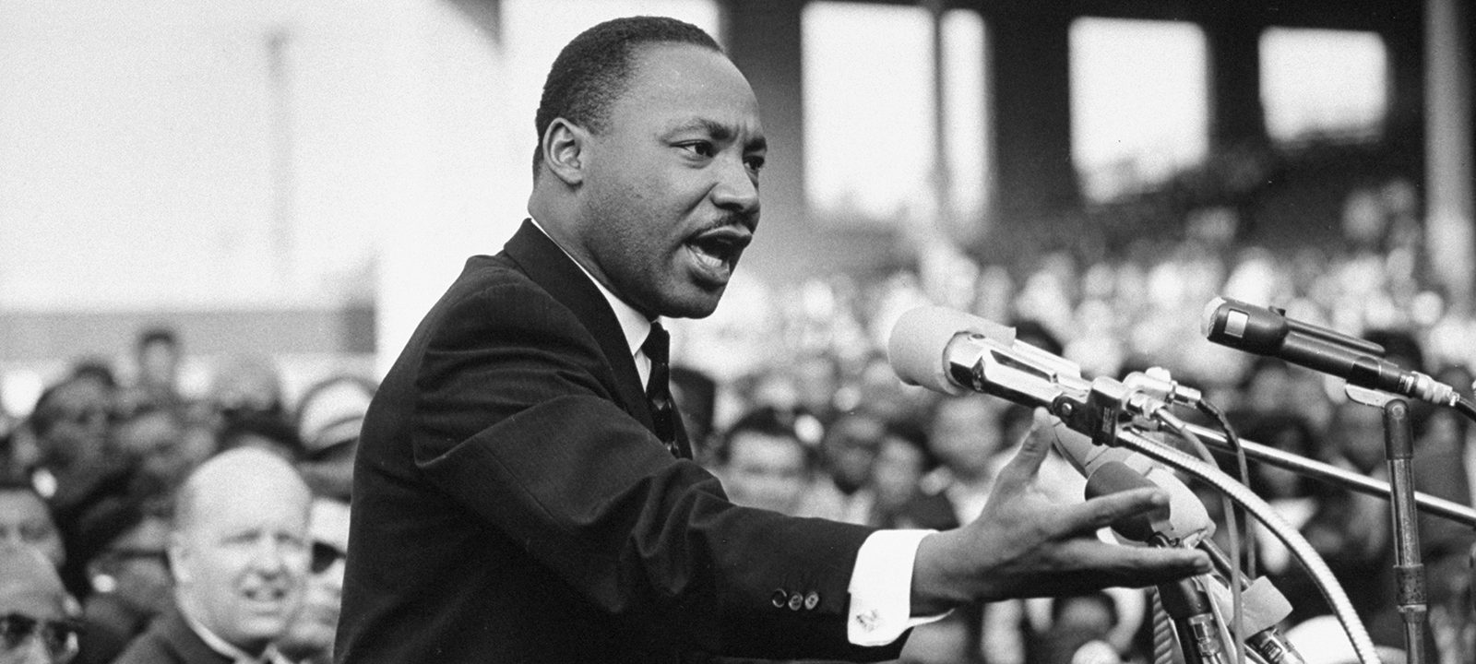
Martin Luther King Jr.
Martin Luther King, Jr. was a social activist and Baptist minister who played a key role in the American civil rights movement from the mid-1950s until his assassination in 1968. King sought equality and human rights for African Americans, the economically disadvantaged and all victims of injustice through peaceful protest.

Slide 10
Questions
What words in the text reveal that Martin Luther King was an African American and spoke differently to other Americans?
Martin Luther King begins with “250,000 people gathered on the Washington Mall to listen to one of the greatest orators and leaders in American history.” Explain why the authors of this graphic novel chose to start their text here? Consider: reader positioning and reader engagement
Examine the use of colour on pages 7 and 8. Why are the colours brighter at the top of page 7 and duller on page 8? Explain how colour is used to reflect the content of the speech bubbles and/or the captions.
Identify the ideas and viewpoints expressed on page 7-8.
Consider the events in America’s past and the events in Australia’s past. Are there any parallels?

Slide 11
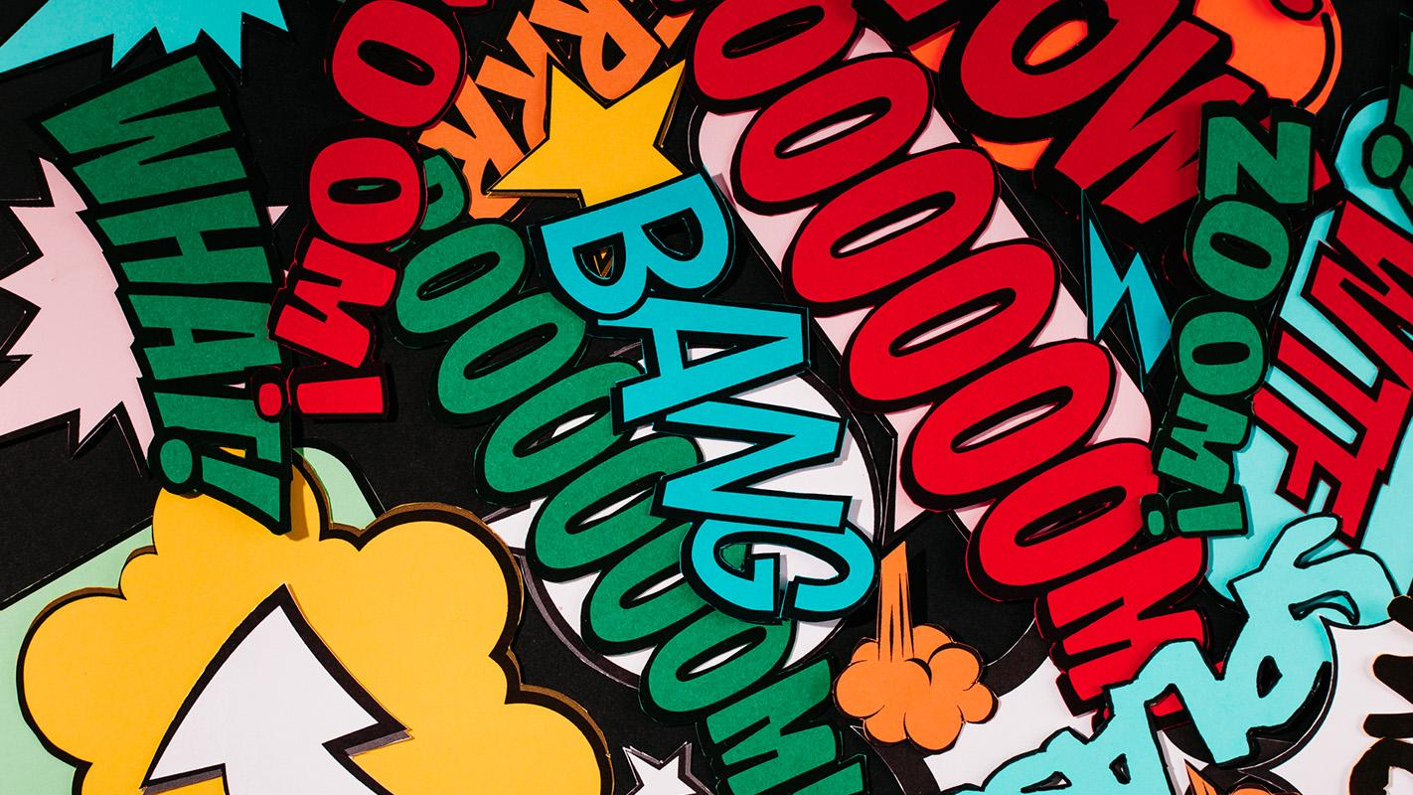
A PICTURE IS WORTH A THOUSAND WORDS

